Slide 1
HUMAN RESOURCES REPORT TO BOE
DECEMBER 11TH, 2017

Slide 2
NATIONAL STUDENT RACIAL DIVERSITY NATIONAL CENTER FOR EDUCATION STATISTICS (NCES)

Slide 3
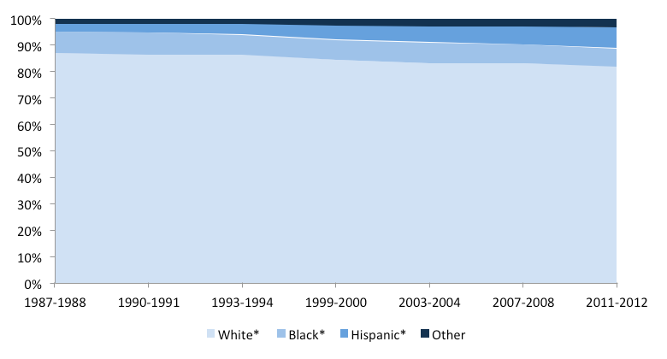
NATIONAL TEACHER RACIAL DIVERSITY NATIONAL CENTER FOR EDUCATION STATISTICS (NCES)
KEY POINTS:
POPULATION OF PUBLIC SCHOOL TEACHERS HAS GRADUALLY BECOME MORE DIVERSE OVER TIME
IN THE 87-88 SCHOOL YEAR, 87% OF PUBLIC SCHOOL TEACHERS WERE WHITE COMPARED TO 82% IN THE 2011-12 SCHOOL YEAR
BLACK EDUCATORS FELL FROM 8% TO 7% IN THIS TIME FRAME
HISPANIC PUBLIC EDUCATORS GREW FROM 3% TO 8%
THE PROPORTION OF TEACHERS WHO WERE ASIAN INCREASED FROM 1% TO 2%

Slide 4
LPS Student Demographics 2017
Race/Ethnicity | Number of Students | Percentage of Students
White | 7,263 | 66.5%
Hispanic | 1,096 | 9.9%
Multi-Racial | 1,049 | 9.6%
Black or African American | 680 | 6.2%
Asian | 444 | 4%
American Indian or Alaskan Native | 349 | 3.1%
Native Hawaiian or other Pacific Islander | 27 | .024%
Total Enrollment: 10,908 students

Slide 5
LPS STAFF RACIAL DIVERSITY Certified
 | 2014-15 | 2015-16 | 2016-17 | 2017-18
American Indian/Alaskan Native | 11 (1.09%) | 9 (0.89%) | 11 (1.09%) | 11 (1.11%)
Black or African American | 22 (2.19%) | 25 (2.46%) | 22 (2.19%) | 24 (2.43%)
White | 938 (93.24%) | 941 (92.62%) | 933 (92.74%) | 914 (92.42%)
Asian | 6 (0.60%) | 7 (0.69%) | 5 (0.50%) | 7 (0.71%)
Native Hawaiian or Other Pacific Islander | 1 (0.10%) | 1 (0.10%) | 1 (.009%) | 1 (0.10%)
Hispanic | 28 (2.78%) | 33 (3.25%) | 34 (3.38%) | 32 (3.24%)
TOTAL | 1006 | 1016 | 1006 | 989

Slide 6
LPS STAFF RACIAL DIVERSITY Classified
 | 2014-15 | 2015-16 | 2016-17 | 2017-18
American Indian/Alaskan Native | 22 (2.92%) | 18 (2.23%) | 25 (3.30%) | 23 (2.96%)
Black or African American | 42 (5.58%) | 57 (7.53%) | 58 (7.66%) | 60 (7.74%)
White | 642 (85.5%) | 629 (83.2%) | 615 (81.2%) | 630 (81.2%)
Asian | 13 (1.72%) | 11 (1.45%) | 11 (1.45%) | 14 (1.8%)
Native Hawaiian or Other Pacific Islander | 1 (0.01%) | 2 (0.02%) | 1 (0.01%) | 1 (0.01%)
Hispanic | 32 (4.25%) | 39 (5.15%) | 47 (6.20%) | 47 (6.06%)
TOTAL | 752 | 756 | 757 | 775

Slide 7
LPS RACIAL DIVERSITY Administrators
 | 2014-15 | 2015-16 | 2016-17 | 2017-18
Black or African American | 3 (5.00%) | 3 (5.26%) | 4 (6.78%) | 4 (6.90%)
White | 57 (95.00%) | 54 (94.74%) | 55 (93.22%) | 54 (93.10%)
Hispanic | 3 (5.00%) | 3 (5.26%) | 3 (5.08%) | 2 (3.45%)
TOTAL | 60 | 57 | 59 | 58

Slide 8
LPS ADDITIONAL ASSIGNMENTS AND NON CONTRACTED RACIAL DIVERSITY
 | 2014-15 | 2015-16 | 2016-17 | 2017-18
American Indian/Alaskan Native | 4 (2.19%) | 5 (2.73%) | 5 (2.84%) | 7 (5.46%)
Black or African American | 13 (7.14%) | 13 (7.10%) | 14 (7.95%) | 10 (7.81%)
White | 149 (81.8%) | 151 (82.51%) | 137 (77.8%) | 98 (76.5%)
Asian | 4 (2.19%) | 3 (0.16%) | 4 (2.27%) | 3 (0.23%)
Native Hawaiian or Other Pacific Islander | 1 (0.05%) | 0 | 0 | 0
Hispanic | 11 (6.04%) | 11 (6.01%) | 16 (9.09%) | 10 (7.81%)
TOTAL | 182 | 183 | 176 | 128

Slide 9
LPS RACIAL DIVERSITY TOTAL STAFF
 | 2014-15 | 2015-16 | 2016-17 | 2017-18
American Indian/Alaskan Native | 37 (1.85%) | 32 (1.58%) | 41 (2.04%) | 41 (2.10%)
Black or African American | 80 (3.99%) | 99 (4.89%) | 98 (4.89%) | 98 (5.01%)
White | 1789 (89.23%) | 1778 (87.76%) | 1743 (86.93%) | 1698 (86.81%)
Asian | 23 (1.15%) | 22 (1.09%) | 20 (1.00%) | 24 (1.23%)
Native Hawaiian or Other Pacific Islander | 2 (0.09%) | 2 (0.10%) | 3 (0.15%) | 4 (0.20%)
Hispanic | 74 (3.69%) | 93 (4.59%) | 100 (4.98%) | 91 (4.65%)
TOTAL | 2005 | 2026 | 2005 | 1956

Slide 10
RECRUITMENT

Slide 11
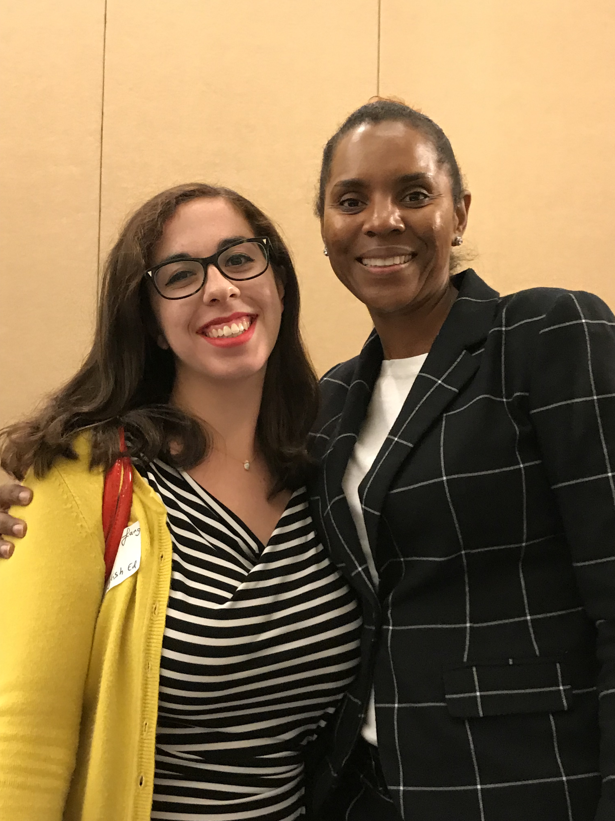
NEW RECRUITMENT SITES
Pittsburgh Education Recruitment
Consortium (PERC)
National Alliance of Black School Educators Conference

Slide 12
CERTIFIED RECRUITMENT FAIR

Slide 13
CLASSIFIED RECRUITMENT FAIR

Slide 14
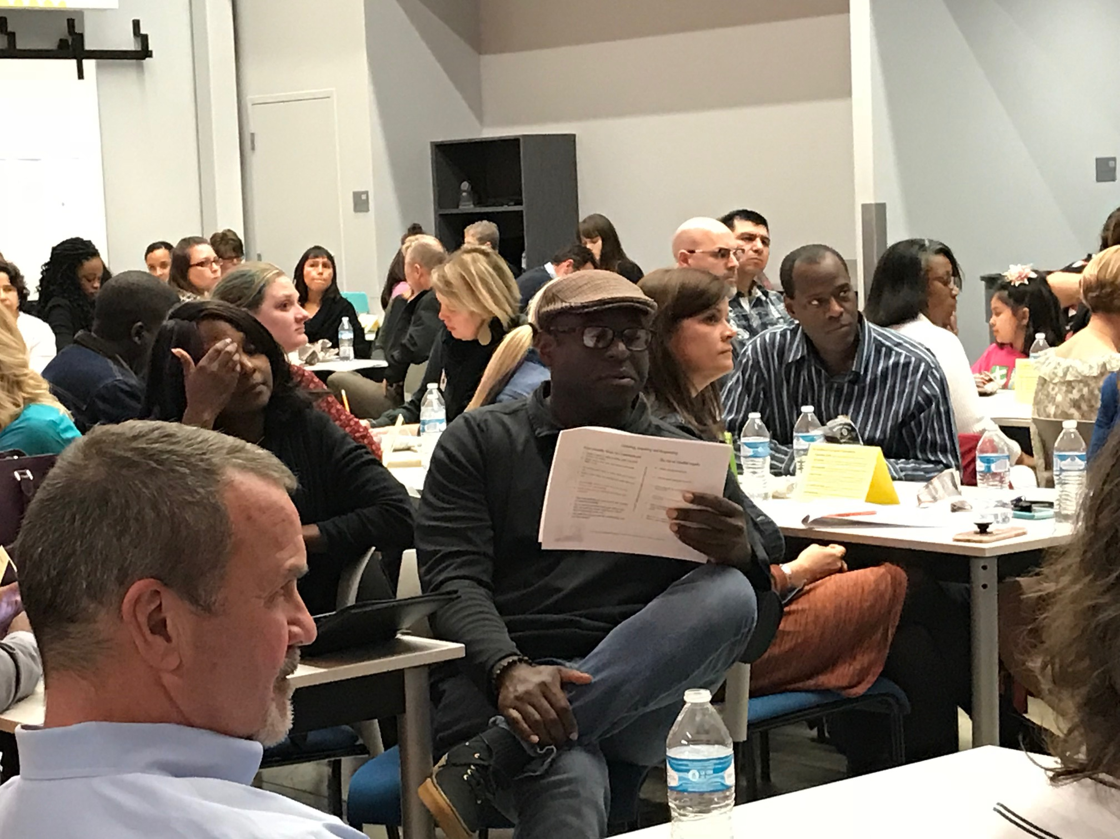
Partnerships for Academically Successful Students
Notes:
We included this slide because it shows the commitment we are to recruit educators that are committed to our equity work. When we recruit at fairs we share our work and engage in conversations with potential teachers about equity.

Slide 15
EXPLORATION OF PARA PATHWAY LICENSURE PROGRAM

Slide 16
Questions??
Notes:
.

